Slide 1

Digital Transformation Plan
Tigertech Communications Limited (Tigertek.io)
Prepared for: Board & Stakeholders
Date: September 2025

Slide 2
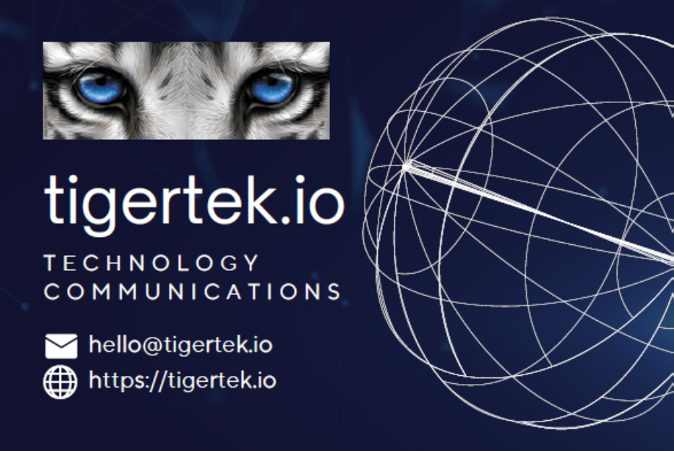

Executive Summary
Tigertek.io is committed to leveraging digital transformation to enhance competitiveness, deliver superior value to clients, and establish itself as a leader in next-generation communications, IoT, and digital infrastructure solutions.

Slide 3

Vision & Objectives
Vision: To position Tigertek.io as a leading digital-first communications and technology integrator, driving innovation in connectivity, IoT, and data-driven services.
Objectives:
• Enhance customer experience
• Optimize operations
• Expand digital services portfolio
• Enable data-driven decision making
• Adopt sustainable & scalable IT

Slide 4

Digital Transformation Pillars
• Customer Experience – Modern website, self-service dashboards, AI support
• Digital Infrastructure – ERP/CRM, cloud, RPA
• Product Innovation – IoT/5G, cybersecurity, AI insights
• Workforce – Upskilling, agile teams, digital HR
• Data & Analytics – Data lake, BI dashboards, predictive models
• Security & Compliance – Zero-trust, GDPR/ISO27001

Slide 5
Roadmap & Phases
Phase 1 (0–6 Months): Foundation – Website, CRM, cloud migration, staff training
Phase 2 (6–18 Months): Acceleration – Self-service portal, RPA, IoT/5G pilots, analytics
Phase 3 (18–36 Months): Leadership – IoT/cybersecurity suite, AI services, ISO certification

Slide 6
KPIs & Success Metrics
• NPS ≥ 70, response < 1 min
• 25% reduction in manual processes (12 months)
• 30% digital services growth (2 years)
• ≥ 3 new services annually
• 80% staff certified in digital skills (Year 2)

Slide 7
Risks & Mitigation
• Resistance – Change management & training
• Cyber threats – SOC, zero-trust, monitoring
• Budget – Agile phasing & cost controls
• Vendor lock-in – Multi-cloud, open-source adoption

Slide 8
Governance & Leadership
• Digital Transformation Office led by CDO
• Cross-functional steering committees
• Quarterly Board progress reports

Slide 9
Conclusion
Tigertek.io will transition into a digitally intelligent, customer-first communications leader, positioned at the forefront of IoT, 5G, and digital infrastructure innovation.

