Slide 1

QR Codes
from Tigertek.io
Solutions for a connected world

Slide 2
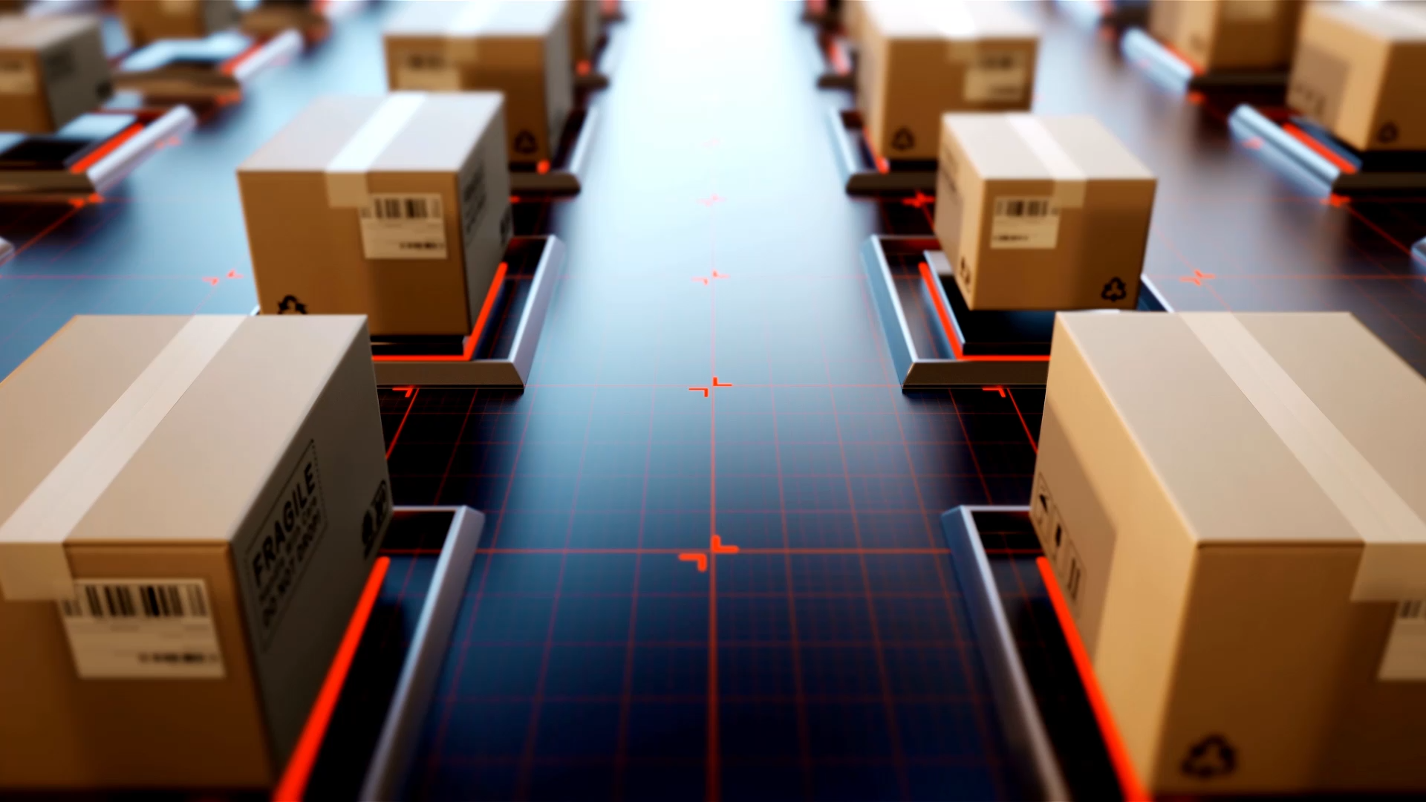
QR Codes
Tigertek.io

Slide 3


Slide 4
Safety of QR Codes in Business
Chicago-based Wintrust Financial and technology provider FIS launched about 200 ATMs. These ATMs have QR Code-based cardless transaction capabilities.
Customers can withdraw money simply by scanning a QR Code at the ATM screen using their Wintrust app.
According to Wintrust and FIS, QR Code-based cardless cash withdrawal takes only 8 seconds compared to 47 seconds for a normal withdrawal. This shows that QR Codes are a faster and more convenient mode of transaction for the users.

Slide 5
Value of QR codes
in your marketing communications to get better engagement
to receive payments from your customers.
inventory management
track your goods and services
add them to business cards can help you get the prospects
for analytics to understand user behavior, optimize future strategy
for business events, relay event information and get guests to RSVP
seamlessly share documents with stakeholders

Slide 6
Security of QR codes in a cyber-conscious world
The best way to ensure QR code security within your business is to work alongside a trusted information technology partner.
This is chiefly because every business is different, and your security needs will vary based on how your business operates, what type of information you store on your devices, and how you and your vendors exchange inventory and inventory-related data.

Slide 7
Value of QR Codes in a commercial world
QR Codes benefit customers by saving time through quick and effortless access to information.
They offer convenience in transactions, particularly in scenarios like cardless cash withdrawals.
QR Codes make print media interactive, allowing customers to participate in contests, provide feedback, or make direct purchases.
Users can easily save contact details or other information with a simple QR Code scan.

Slide 8
QR Codes
from Tigertek.io
Technology partner of Phoenix Enterprises

